Slide 1
MEMORY ORGANISATION

Slide 2

Memory Hierarchy
Main Memory
Auxiliary Memory
Associative Memory
Cache Memory
Virtual Memory
2

Slide 3
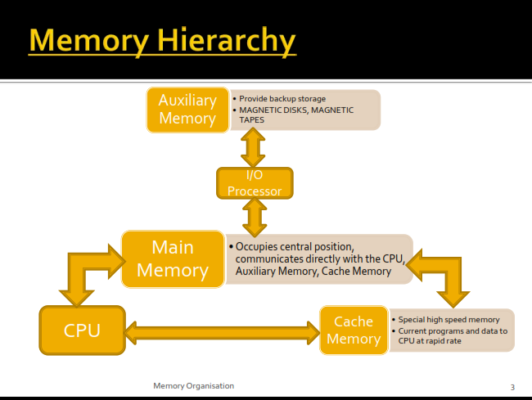

Slide 4

○
CPU logic is usually faster than main memory access time,
with the result that processing speed is limited primarily by
the speed of main
memory.
○
The cache is used
being executed in
for storing segments of programs currently
the CPU and temporary data frequently
needed in the present calculations.
○
The typical access time ratio between cache and main memory
is about 1 to 7~10 .
○
Auxiliary memory access time is usually 1000 times that of
main memory.
Memory Organisation
4

Slide 5






○ The memory hierarchy system consists of all storage devices
employed in a computer system from the slow by high-
capacity auxiliary memory to a relatively faster main
memory, to an even smaller and faster cache memory.
Register
Memory
Cache
Memory
Increasing order of
access time ratio
Main Memory
Primary Memory
Magnetic Disks
Auxiliary Memory
Or
Secondary Memory
Magnetic Tapes
Memory Organisation
5

Slide 6

Each memory is a collection of various memory location.
Accessing the memory means finding and reaching desired
location and than reading information from memory
location. The information from locations can be accessed as
follows:
Random access
Sequential access
Direct access
Random Access: It is the access mode where each memory
○
1.
2.
3.
○
location has a unique address. Using these unique addresses
each memory location can be addressed independently in
any order in equal amount of time. Generally, main
memories are random access memories(RAM).
Memory Organisation
6

Slide 7
○ Sequential Access: If storage locations can be accessed only
in a certain predetermined sequence, the access method is
known as serial or sequential access.
▪ Opposite of RAM: Serial Access Memory (SAM). SAM works very well for memory buffers, where the data is normally stored in the order in which it will be used (a good example is the texture buffer memory on a video card , magnetic tapes, etc.).
○ Direct Access: In this access information is stored on tracks
and each track has a separate read/write head. This features
makes it a semi random mode which is generally used in
magnetic disks.
Memory Organisation
7

Slide 8
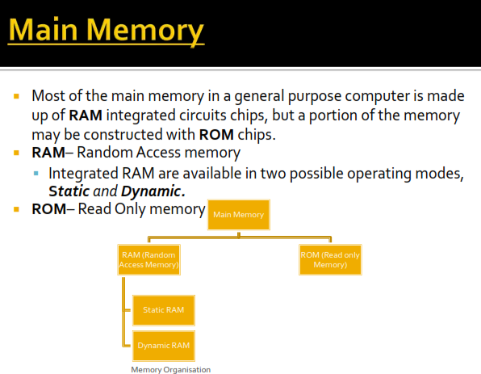

Slide 9
What is RAM??
Memory Organisation
9

Slide 10

○ RAM is used for storing bulk of programs and data
that is subject to change.
0
words
(8 bits (one byte) per word)
Typical RAM chip
Chip select 1
Chip select 2
Read
Write
7-bit address
CS1 CS2
RD ^{128 x 8}
WR AD 7
RAM
8-bit data bus
127
CS1 CS2 RD WR
Memory function
State of data bus
0 0 x x
0 1 x x
1 0 0 0
1 0 0 1
1 0 1 x
1 1 x x
Inhibit
Inhibit
Inhibit
Write
Read
Inhibit
High-impedence
High-impedence
Output data from RAM
High-impedence
Input data to RAM
High Impedence
Memory Organisation
10

Slide 11

○
Static RAM (SRAM)
▪ Each cell stores bit with a six-transistor circuit.
▪ Retains value indefinitely, as long as it is kept powered.
▪  Faster (8-16 times faster) and more expensive (8-16 times more expensive as well) than DRAM.
Dynamic RAM (DRAM)
▪ Each cell stores bit with a capacitor and transistor.
▪ Value must be refreshed every 10-100 ms.
▪ Slower and cheaper than SRAM. Has reduced power consumption, and a large storage capacity.
In contrast to , SRAM and DRAM:
Non Volatile RAM (NVRAM)
▪ retains its information when power is turned off (non volatile).
▪ best-known form of NVRAM memory today is flash memory.
○
▪
Virtually all desktop or server computers since 1975 used DRAMs for main memory and
SRAMs for cache.
Memory Organisation
11

Slide 12

It is non-volatile memory, which retains the data even
when power is removed from this memory. Programs
and data that can not be altered are stored in ROM.
ROM is used for storing programs that are
PERMANENTLY resident in the computer and for
tables of constants that do not change in value once
the production of the computer is completed.
The ROM portion of main memory is needed for
storing an initial program called bootstrap loader,
which is to start the computer operating system when
power is turned on.
○
○
○
Memory Organisation
12

Slide 13
○ Typical ROM chip:
Chip select 1
Chip select 2
CS1
CS2
512 x 8
ROM
AD 9
8-bit data bus
9-bit address
○ Since the ROM can only READ, the data bus can only be in
output mode.
○ No need of READ and WRITE control.
○ Same sized RAM and ROM chip , it is possible to have more
bits of ROM than of RAM , because the internal binary cells
in ROM occupy less space than in RAM.
Memory Organisation
13

Slide 14

○ The required paths in a ROM may be programmed in
different ways:
four
1. Mask Programming: It is done by the company during the
fabrication process of the unit. The procedure for fabricating a
ROM requires that the customer fills out the truth table he
wishes the ROM to satisfy.
2. Programmable Read only memory(PROM):
PROM contain all the fuses intact giving all 1’s in the bits of the
stored words. A blown fuse defines binary 0 state and an intact
fuse give a binary 1 state. This allows the user to program the
PROM by using a special instruments called PROM
programmer.
Memory Organisation
14

Slide 15
3. Erasable PROM(EPROM): In a PROM once fixed pattern is
permanent and can not be altered. The EPROM can be
restructured to the initial state even through it has been
programmed previously. When EPROM is placed under a
special ultra-violet light for a given period of time all the data
are erased. After erase, the EPROM returns to it initial state
and can be programmed to a new set of values.
4. Electrically Erasable PROM(EEPROM): It is similar to
EPROM except that the previously programmed connections
can be erased with an electrical signal instead of ultra violet
light. The advantage is that device can be erased without
removing it from it’s socket.
Memory Organisation
15

Slide 16

○
Also called as Secondary Memory, used to store large chunks
of data at a lesser cost per byte than a primary memory for
backup.
It does not lose the data when the device is powered down—
it is non-volatile.
It is not directly accessible by the CPU, they are accessed via the input/output channels.
The most common form of auxiliary memory devices used in consumer systems is flash memory, optical discs, and magnetic disks, magnetic tapes.
○
○
○
Memory Organisation
19

Slide 17
○
Flash memory: An electronic non-volatile
computer storage device that can be electrically
erased and reprogrammed, and works without
any moving parts. Examples of this are USB
flash drives and solid state drives.
Optical disc: Its a storage medium from which
○
data is read and to which it is written by lasers.
There are three basic types of optical disks: CD-
ROM (read-only), WORM (write-once read-
many) & EO (erasable optical disks).
Memory Organisation
20

Slide 18
○
Magnetic tapes: A magnetic
file i
block
tape consists of electric,
mechanical and electronic
components to provide the
parts and control mechanism
for a magnetic tape unit.
block 1
2
block 3
EOF
R1
R2 R3
^{R4} R5
block 3 IRG
R6
EOF
R1
R5
R4
R3
R2
block 1
block 2
○
The tape itself is a strip of
plastic coated with a magnetic
recording medium. Bits are
recorded as magnetic spots on
tape along several tracks called
RECORDS.
•
R/W heads are mounted in each track so that
data can be recorded and read as a
sequence of characters.
•
Can be stopped , started to move forward,
Each record on tape has an
identification bit pattern at the
beg. and the end.
Memory Organisation
or in reverse, or can be rewound, but cannot be
stopped fast enough between individual
characters.
○
21

Slide 19
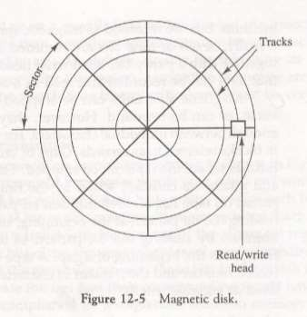
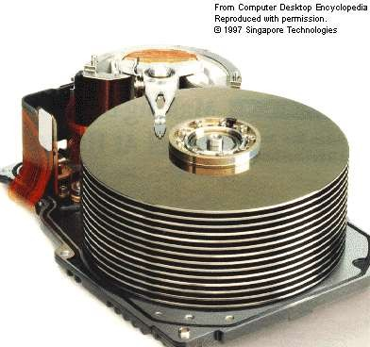
Magnetic Disk:
○
A magnetic disk is a circular plate
constructed of metal or plastic coated with magnetized material.
Both sides of the disk are used and several disks may be stacked on one spindle with read/write heads available on each surface.
Bits are stored in magnetized surface in spots along concentric circles called tracks. Tracks are commonly divided into sections called sectors.
Disk that are permanently attached and
cannot removed by occasional user are called hard disks.
○
○
○
Memory Organisation
22

Slide 20
• A memory unit accessed by contents
an associative memory or content
addressable memory(CAM).
is
called
• This type of memory is accessed
simultaneously and in parallel on the
basis of
data content rather than by specific address
or location.

Slide 21
○ Write operation:
▪ When a word is written in in an associative memory,
no address is given.
▪ The memory is capable of finding an unused location
to store the word.
○ Read operation:
▪ When a word is to be read from an associative
memory, the contents of the word, or a part of the
word is specified.
▪ The memory locates all the words which match the
specified content and marks them for reading.

Slide 22
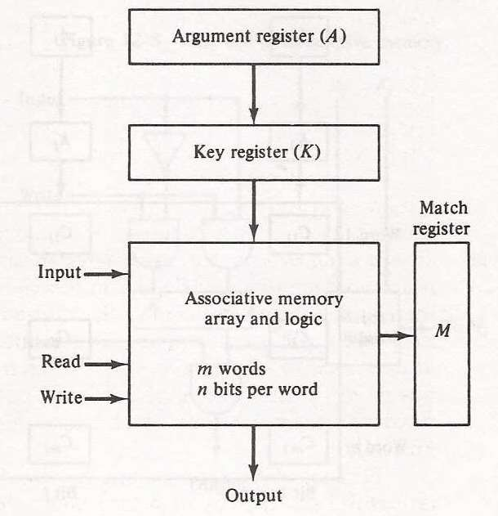
Argument register(A): It contains
the word to be searched. It has n
bits(one for each bit of the word).
Key Register(K): It provides mask
for choosing a particular field or key
in the argument word. It also has n
bits.
Associative memory array: It
contains the words which are to be
compared with the argument word.
Match Register(M):It has m bits, one
bit corresponding to each word in
the memory array . After the
matching process, the bits
corresponding to matching words in
match register are set to 1.

Slide 23
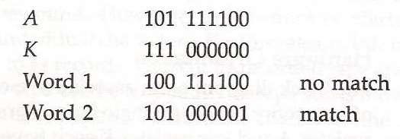
• The entire argument word is compared with each memory word, if the
key register contains all 1’s. Otherwise, only those bits in the argument
that have 1’s in their corresponding position of the key register are
compared.
•Thus the key provides a mask or identifying piece of information which
specifies how the reference to memory is made.
•To illustrate with a numerical example, suppose that the argument
register A and the key register K have the bit configuration as shown
below.
•Only the three left most bits of A are compared with the memory words
because K has 1’s in these three positions only.

Slide 24

○ An associative memory is more expensive
than a random access memory because each
cell must have an extra storage capability as
well as logic circuits for matching its content
with an external argument.
○ For this reason, associative memories are
used in applications where the search time is
very critical and must be very short.

Slide 25

○
If the active portions of the program and data are
placed in a fast small memory, the average
memory access time can be reduced.
Thus reducing the total execution time of the
program
Such a fast small memory is referred to as cache
memory
The cache is the fastest component in the memory
hierarchy and approaches the speed of CPU
component
○
○
○

Slide 26
○
When CPU needs to access memory, the cache is
examined.
If the word is found in the cache, it is read from the cache
memory.
If the word addressed by the CPU is not found in the
cache, the main memory is accessed to read the word.
A block of words containing the one just accessed is then
transferred from main memory to cache memory.
If the cache is full, then a block equivalent to the size of
the used word is replaced according to the replacement
algorithm being used.
○
○
○
○

Slide 27

○ When the CPU refers to memory and finds
the word in cache, it is said to produce a hit
○ Otherwise, it is a miss
○ The performance of cache memory is
frequently measured in terms of a quantity
called hit ratio
Hit ratio = hit / (hit+miss)

Slide 28

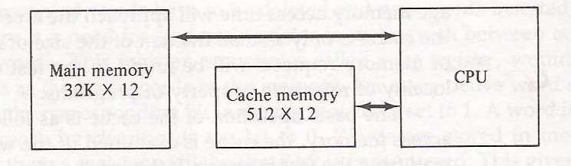
•The transformation of data from main memory to cache
memory is referred to as a mapping process, there are
three types of mapping:
▪Associative mapping
▪Direct mapping
▪Set-associative mapping
•To help understand the mapping procedure, we have the
following example:

Slide 29

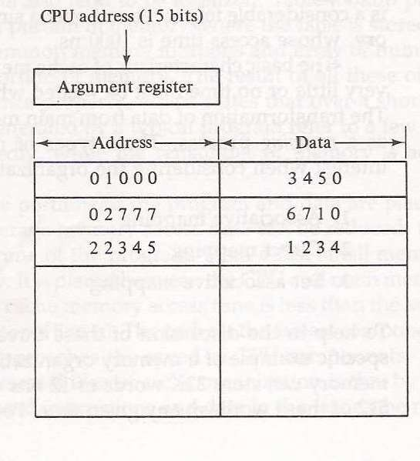
○
The fastest and most flexible cache
organization uses an associative
memory.
○
The associative memory stores both
the address and data of the memory
word.
○
This permits any location in cache to
store a word from main memory.
○
The address value of 15 bits is shown
as a five-digit octal number and its
corresponding 12-bit word is shown as
a four-digit octal number

Slide 30

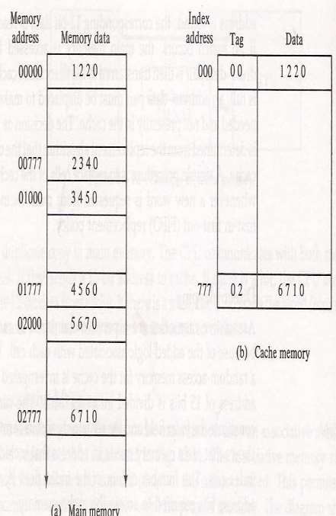
○
Associative memory is
expensive compared to
RAM.
In general case, there are
2^k words in cache
memory and 2^n words in
main memory (in our
case, k=9, n=15).
The n bit memory address
is divided into two fields:
k-bits for the index and
n-k bits for the tag field.
○
○

Slide 31
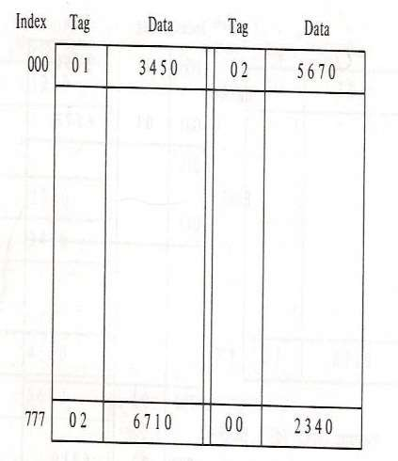
○
The disadvantage of direct
mapping is that two words with the same index in their address but with different tag values cannot reside in cache memory at the same time.
○
Set-Associative Mapping is an
improvement over the direct-
mapping in that each word of
cache can store two or more
word of memory under the
same index address.

Slide 32
○ Optimal replacement algorithm – find the
block for replacement that has minimum
chance to be referenced next time.
○ Two algorithms:
▪ FIFO: Selects the item which has been in the set the
longest.
▪ LRU: Selects the item which has been least recently used by the CPU.

Slide 33

○ Virtual memory is a common part of
operating system on desktop computers.
○ The term Virtual Memory refers to something
which appears to be present but actually is
not.
○ This technique allows users to use more
memory for a program than the real memory
of a computer.

Slide 34
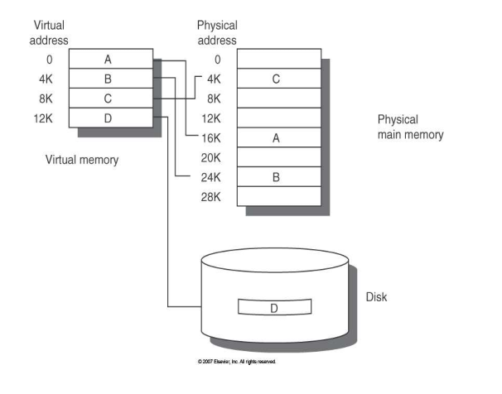

Slide 35
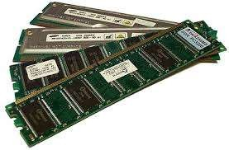
○
Virtual Memory is a imaginary memory which
we assume or use, when we have a material
that exceeds our memory
at
that
time.
▪
Virtual Memory is
temporary memory
which is used along
with the ram of the
system.

Slide 36

○ Allows Processes whose aggregate memory
requirement is greater than the amount of
physical memory, as infrequently used pages
can reside on the disk.
○ Virtual memory allows speed gain when only a
particular segment of the program is required
for the execution of the program.
○ This concept is very helpful in implementing
multiprogramming environment.

Slide 37

○ Applications run rather slower when they
using virtual memory.
are
○ It takes more time to switch
applications.
between
○ Reduces system stability.

